Slide 1


, , , and what we can do with them
Claire Boyd
Data Scientist
NYC Department of Finance, Property Modeling & Valuation
boydclaire@finance.nyc.gov

Slide 2


A little about me
Born/raised in Manhattan
Researcher at Urban Institute
Studied Computer Science and Public Policy at UChicago
Worked at Cook County Assessors Office and Mansueto Institute for Urban Innovation, applying data science in the property assessment space
Now at DOF - excited about using and building open-source tools to enhance the work we do for the City of New York

Slide 3
The power of open-source tools.

Slide 4
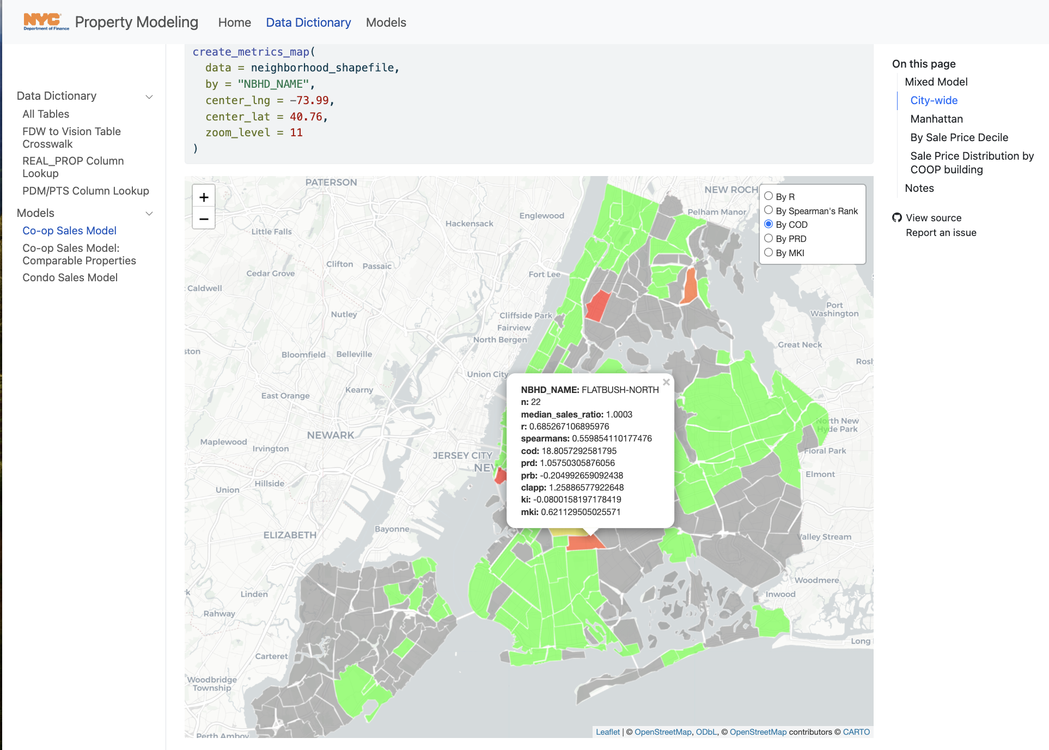
Building interactive data visualizations using open-source tools
Free to create, modify, and host a public website
Created with open-source code, which means it’s well documented and there are a lot of resources to help replicate different features
Maps built in R using an open-source library called leaflet
Html for websites is rendered using quarto (a publishing library)
Site is hosted using GitHub pages
Using git/GitHub is core to being able to easily access or develop open-source tools
https://nycdepartmentoffinance.github.io/models/coop_sales_model.html

Slide 5
What you’ll learn today
What is git?
What is GitHub?
Why use it?
How does it work?
What can you do with it?
Please stop me to ask questions throughout!

Slide 6
Imagine this.

Slide 7
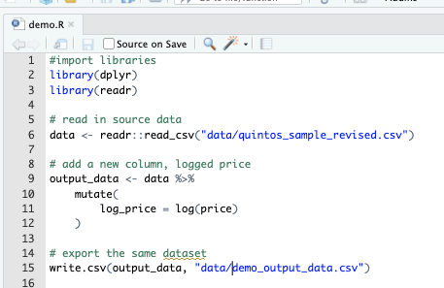
You and a coworker are tasked to work on a project demo.R. The goal is to add a few more columns to an existing csv (logged price, logged estimate, price-estimate, log_price-log_estimate).
How would you work on this task so that your work was version controlled (saved regularly)?
How would you collaborate on this?
How would you combine your work when its finished, assuming someone else might want to repeat this process another time?
Where would you store the finished product so that your team knew it was the final version?
Notes:
What problems might come up along the way?
If using the same file:
Not being able to edit the same script at once
If using different file copies:
Forgetting chunks of code when copying and pasting into one version
Calling variables different names
Importing different packages
Multiple files with the same name, but different versions

Slide 8
Enter .

Slide 9
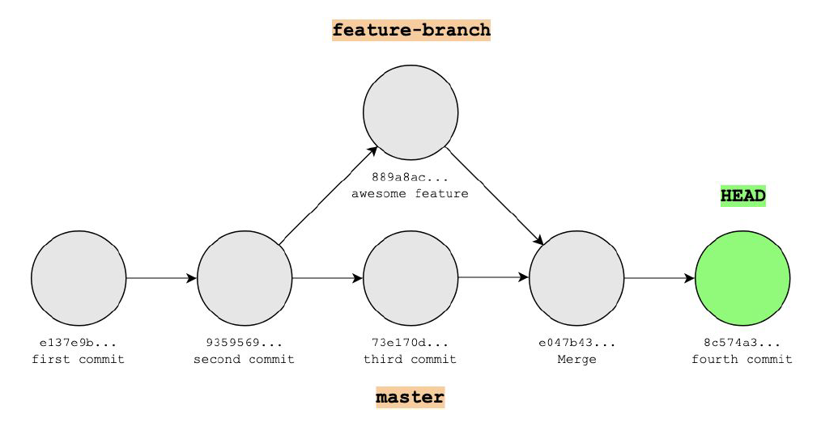
git
git is a version control system that keeps track of all changes made in a folder (repository/repo)
A historical backup of “snapshots” of your work
Think of it as a “Save As” version
git can track branches, or different versions of the same folder locally, so you can try out two different things at one (e.g. master vs. feature-branch)
It is natively a command line interface (CLI) tool
git saves a stream of snapshots (called commits)

Slide 10
git
git is a version control system that keeps track of all changes made in a folder (repository/repo)
A historical backup of “snapshots” of your work
Think of it as a “Save As” version
git can track branches, or different versions of the same folder locally, so you can try out two different things at one (e.g. master vs. feature-branch)
It is natively a command line interface (CLI) tool
git saves a stream of snapshots (called commits)

Slide 11
git
git is a version control system that keeps track of all changes made in a folder (repository/repo)
A historical backup of “snapshots” of your work
Think of it as a “Save As” version
git can track branches, or different versions of the same folder locally, so you can try out two different things at one (e.g. master vs. feature-branch)
It is natively a command line interface (CLI) tool but can also be used using a Desktop App
git saves a stream of snapshots (called commits)

Slide 12
git
git is a version control system that keeps track of all changes made in a folder (repository/repo)
A historical backup of “snapshots” of your work
Think of it as a “Save As” version
git can track branches, or different versions of the same folder locally, so you can try out two different things at one (e.g. master vs. feature-branch)
It is natively a command line interface (CLI) tool but can also be used using a Desktop App
git saves a stream of snapshots (called commits)

Slide 13
git
git is a version control system that keeps track of all changes made in a folder (repository/repo)
A historical backup of “snapshots” of your work
Think of it as a “Save As” version
git can track branches, or different versions of the same folder locally, so you can try out two different things at one (e.g. master vs. feature-branch)
It is natively a command line interface (CLI) tool but can also be used using a Desktop App
git saves a stream of snapshots (called commits)

Slide 14
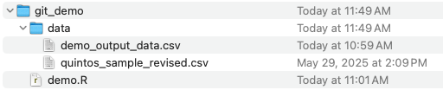
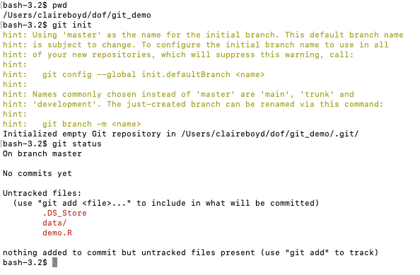
How do you save these commits (“snapshots”)?
Folder on my local machine
In a Terminal/Command Prompt
Step 1: Initialize a git repository (git init)

Slide 15
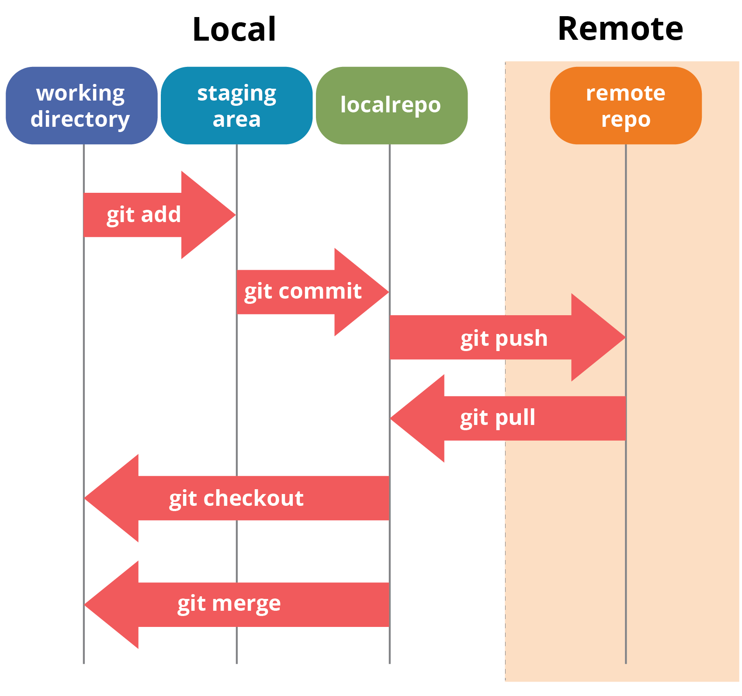
How do you save these commits (“snapshots”)?
Folder on my local machine
In a Terminal/Command Prompt
Step 1: Initialize a git repository (git init)
Check the status

Slide 16
How do you save these commits (“snapshots”)?
Folder on my local machine
In a Terminal/Command Prompt
Step 1: Initialize a git repository (git init)
Check the status

Slide 17
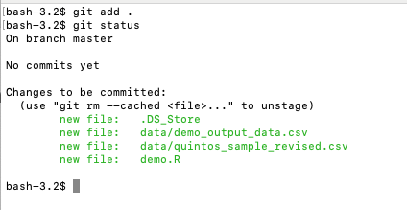
How do you save these commits (“snapshots”)?
In a Terminal/Command Prompt
Step 2: Add all files to “staging area” (git add)

Slide 18
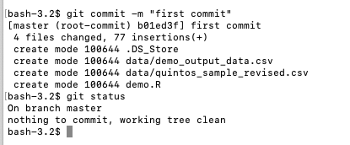
How do you save these commits (“snapshots”)?
In a Terminal/Command Prompt
Step 3: Commit changes to git (git commit)

Slide 19
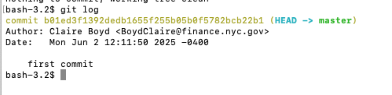
How do you save these commits (“snapshots”)?

Slide 20
What have we done so far?
We initialized an existing folder on our computer as a git repository (a folder that git tracks the changes of)
We checked the status of the folder (what files have changed or been added/deleted)
We added the contents of that folder to our “staging” area
We committed the contents of the “staging” area to git
We checked the status of the folder again and saw that there were no new changes since our last commit.
We looked at the log and saw that our commit was saved with the message.

Slide 21
You and a coworker are tasked to work on a project demo.R. The goal is to add a few more columns to an existing csv (logged price, logged estimate, price-estimate, log_price-log_estimate).
How would you work on this task so that your work was version controlled (saved regularly)?
How would you collaborate on this?
How would you combine your work when its finished, assuming someone else might want to repeat this process another time?
Where would you store the finished product so that your team knew it was the final version?

Slide 22
Enter .

Slide 23
GitHub
GitHub is a website that hosts repositories (folders) under version control by git.
It is the remote (cloud) storage for repositories (folders) that allows us to work together on the same material.
Git push – we are pushing the changes we made on our machines to the version saved on the website.
Git pull – we are pulling the changes from the website down to our local machines to keep the versions consistent.
It allows for team development
Different versions of the project (these “snapshots”) can be merged together to create one final version
Allows for simultaneous work

Slide 24
GitHub
GitHub is a website that hosts repositories (folders) under version control by git.
It is the remote (cloud) storage for repositories (folders) that allows us to work together on the same material.
Git push – we are pushing the changes we made on our machines to the version saved on the website.
Git pull – we are pulling the changes from the website down to our local machines to keep the versions consistent.
It allows for team development
Different versions of the project (these “snapshots”) can be merged together to create one final version
Allows for simultaneous work

Slide 25
GitHub
GitHub is a website that hosts repositories (folders) under version control by git.
It is the remote (cloud) storage for repositories (folders) that allows us to work together on the same material.
Git push – we are pushing the changes we made on our machines to the version saved on the website.
Git pull – we are pulling the changes from the website down to our local machines to keep the versions consistent.
It allows for team development
Different versions of the project (these “snapshots”) can be merged together to create one final version
Allows for simultaneous work

Slide 26
90% of Fortune 500 Companies use GitHub
In 2022, there were 3.5 billion contributions to GitHub projects, 20% were made to public repos the rest to private repos.
GitHub is used by over 4 million organizations, and more than 100 million developers
1.5% percent of internet users use GitHub

Slide 27
GitHub
GitHub is a website that hosts repositories (folders) under version control by git.
It is the remote (cloud) storage for repositories (folders) that allows us to work together on the same material.
Git push – we are pushing the changes we made on our machines to the version saved on the website.
Git pull – we are pulling the changes from the website down to our local machines to keep the versions consistent.
It allows for team development
Different versions of the project (these “snapshots”) can be merged together to create one final version
Allows for simultaneous work

Slide 28
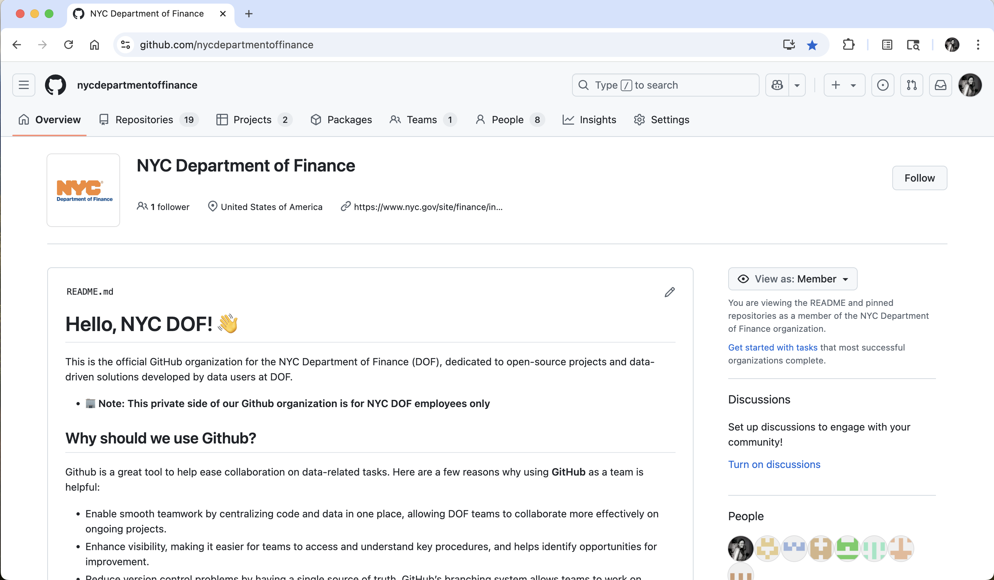

Slide 29
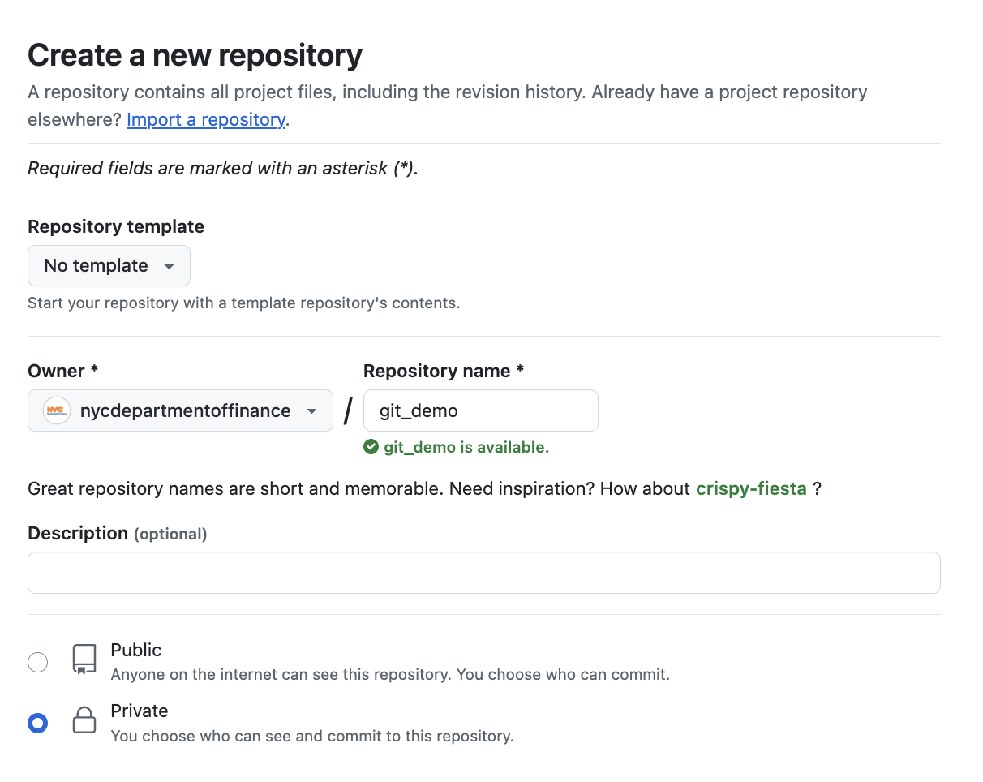
How do you push your local folder to GitHub?
On GitHub
Step 1: Create remote repository

Slide 30
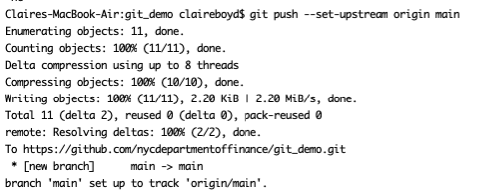
How do you push your local folder to GitHub?
In a Terminal/Command Prompt
Step 2: Add remote repo as “origin”
Step 3: Pushing changes to remote repo

Slide 31
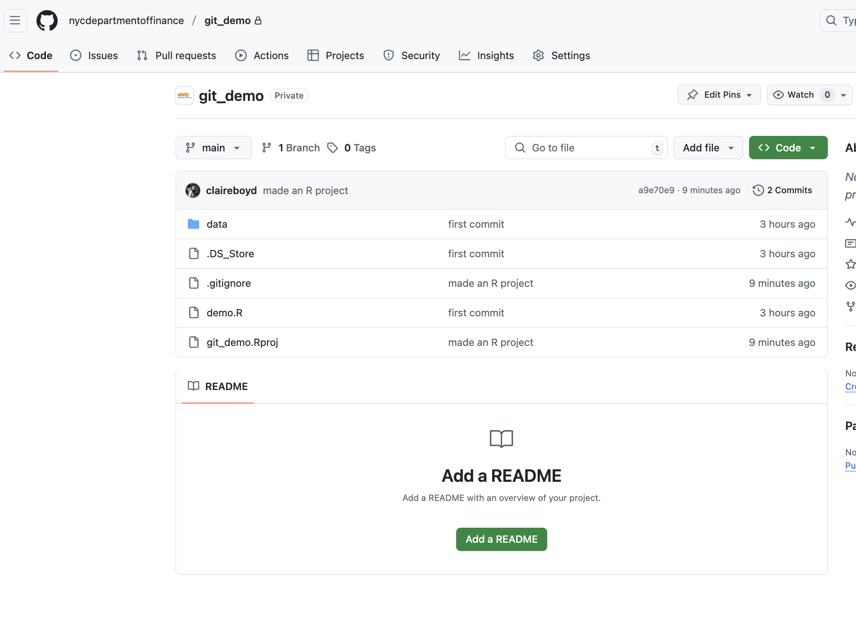
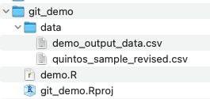
GitHub
Local Machine
git

Slide 32
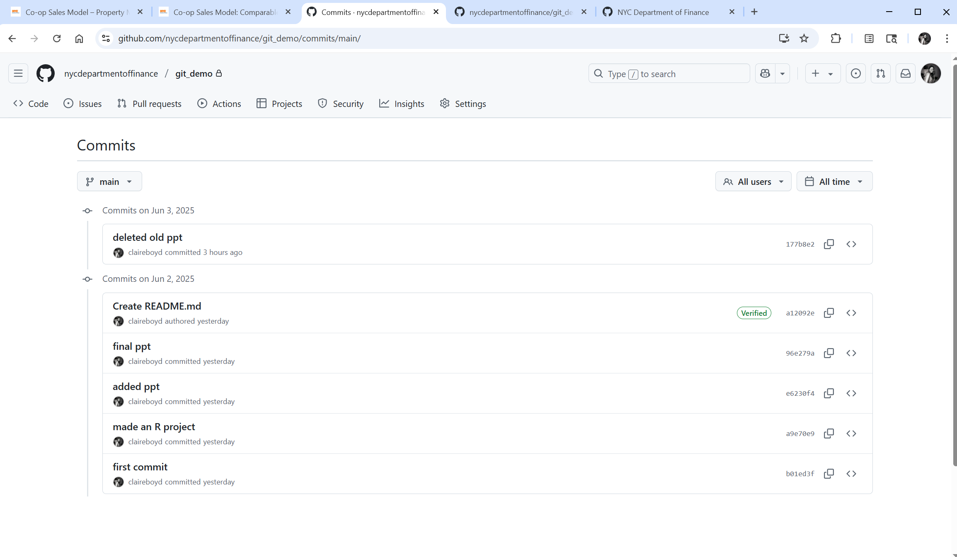

Slide 33
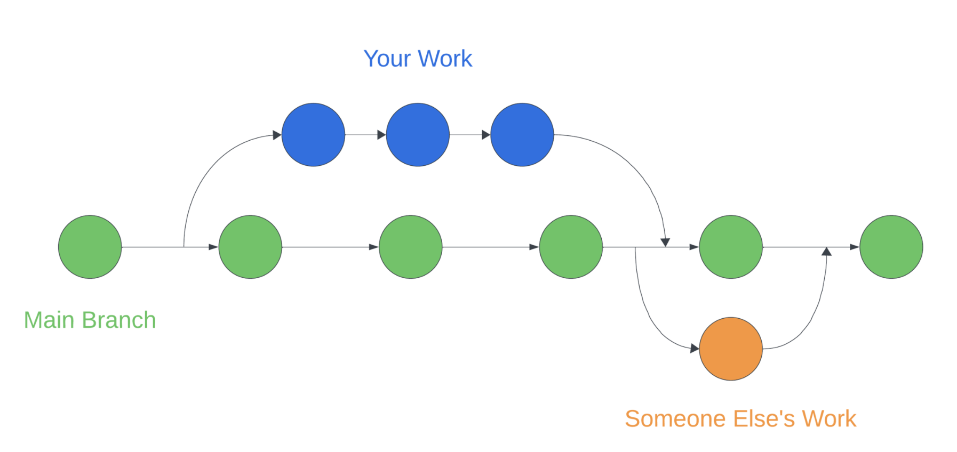
Working alone
Collaborating with others
Your Branch
Coworker’s Branch

Slide 34
You and a coworker are tasked to work on a project demo.R. The goal is to add a few more columns to an existing csv (logged price, logged estimate, price-estimate, log_price-log_estimate).
How would you work on this task so that your work was version controlled (saved regularly)?
How would you collaborate on this?
How would you combine your work when its finished, assuming someone else might want to repeat this process another time?
Where would you store the finished product so that your team knew it was the final version?

Slide 35
Benefits to DOF for using git/GitHub for version control/data storage
Streamline onboarding for new hires in data-related roles where all set up and guidance on how to get started live in one place (re: proxy server)
Open more avenues for collaboration between analysts on the same team or across teams, allowing more insight into other teams work and potential opportunities for more collaboration
Increase stability of data pipelines/products by using version control. If something breaks or is not working as it is intended, it takes 2 clicks to revert changes reliably.
Add flexibility to how analysts can work, if remote connection is unreliable or slow
Attract/retain data science talent for programmers that are interested in active collaboration on data science products, because using these tools is the industry standard

Slide 36
Interactive data visualization, hosted by GitHub pages

Slide 37
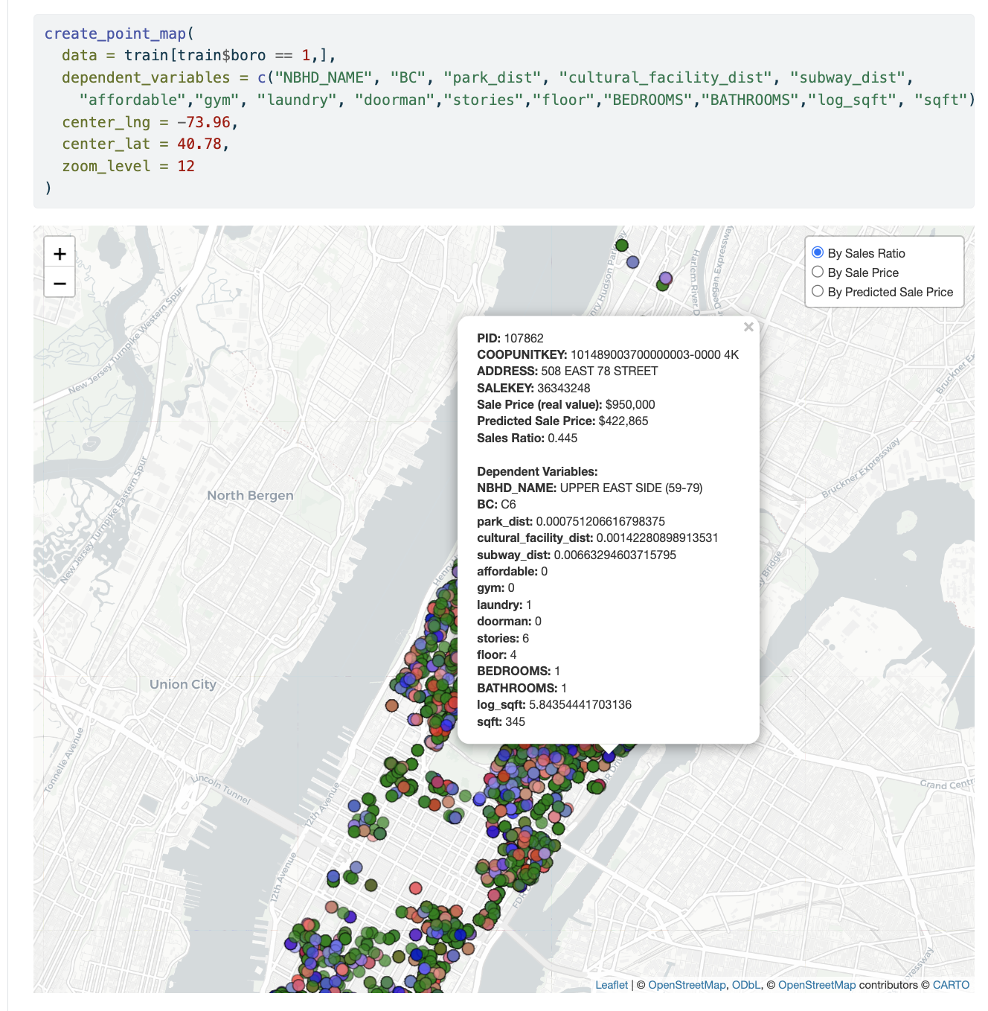
https://nycdepartmentoffinance.github.io/models/coop_sales_model.html

Slide 38
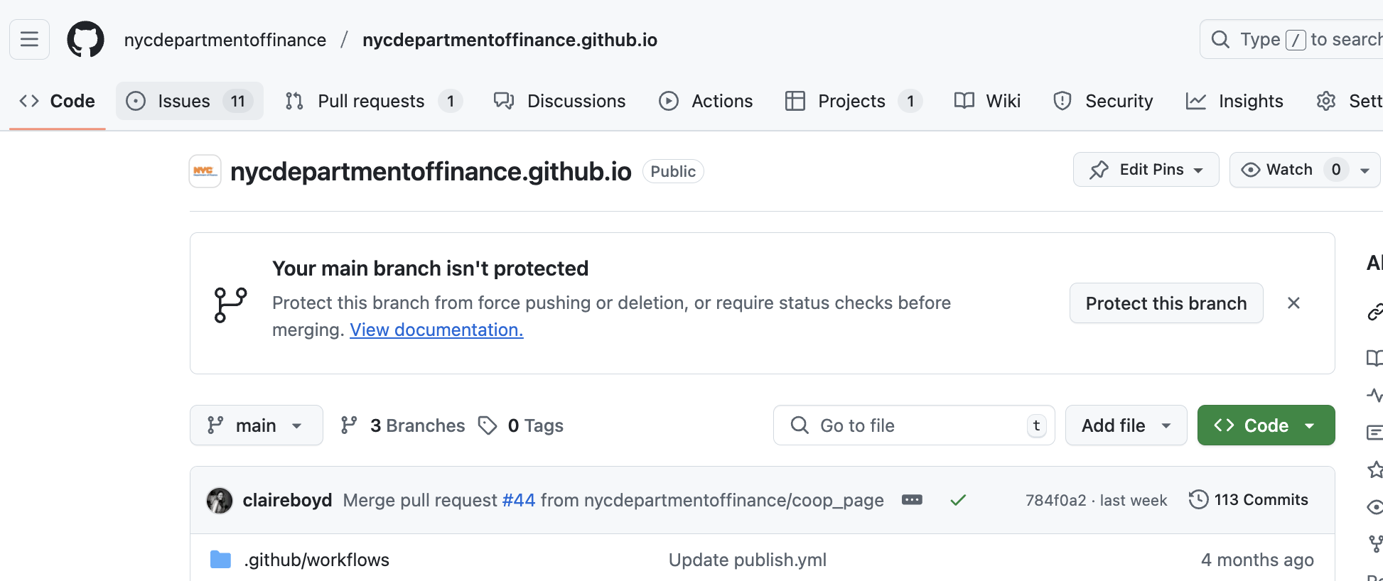
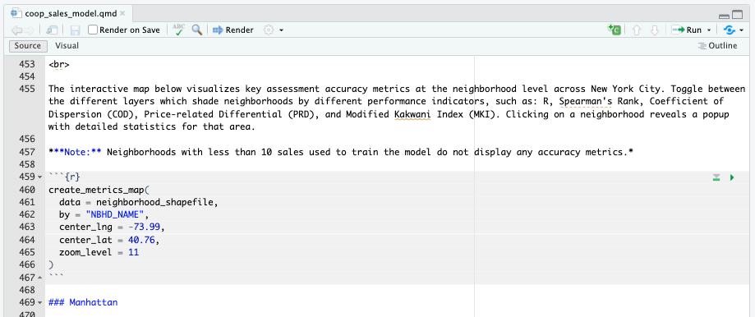
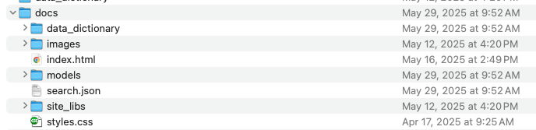
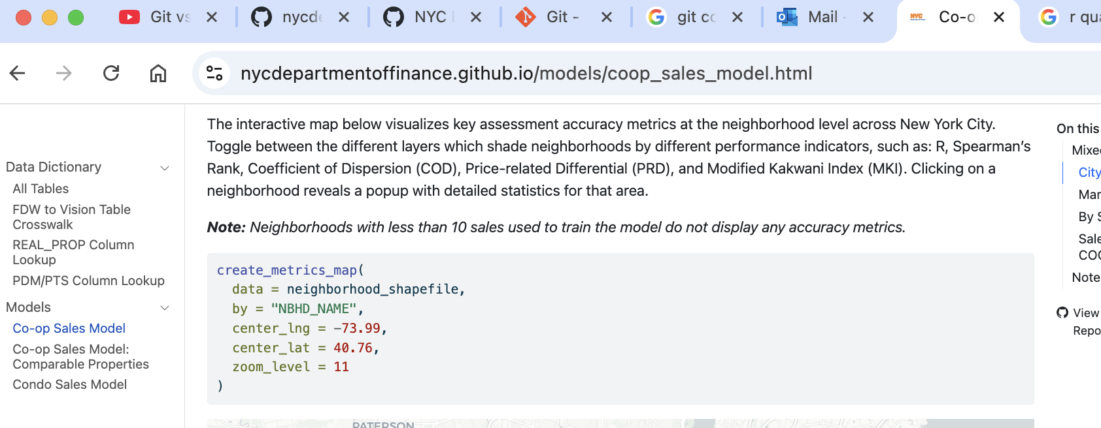
GitHub
Local Machine
git
GitHub Action
Quarto render
Static Site

Slide 39
Why use and ?

Slide 40
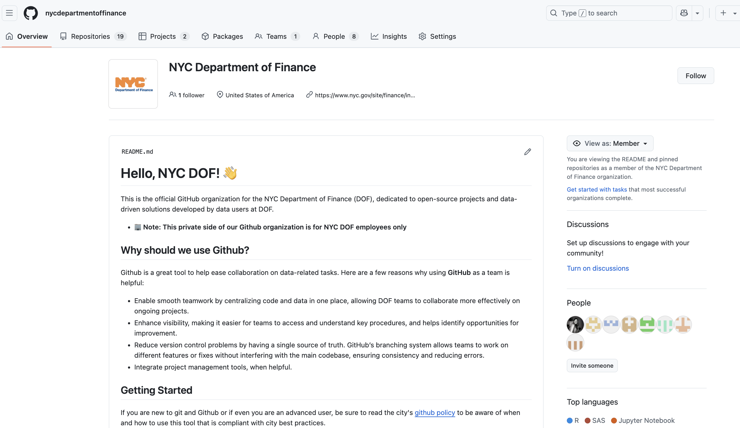
Host internal/external documentation or onboarding materials

Slide 41
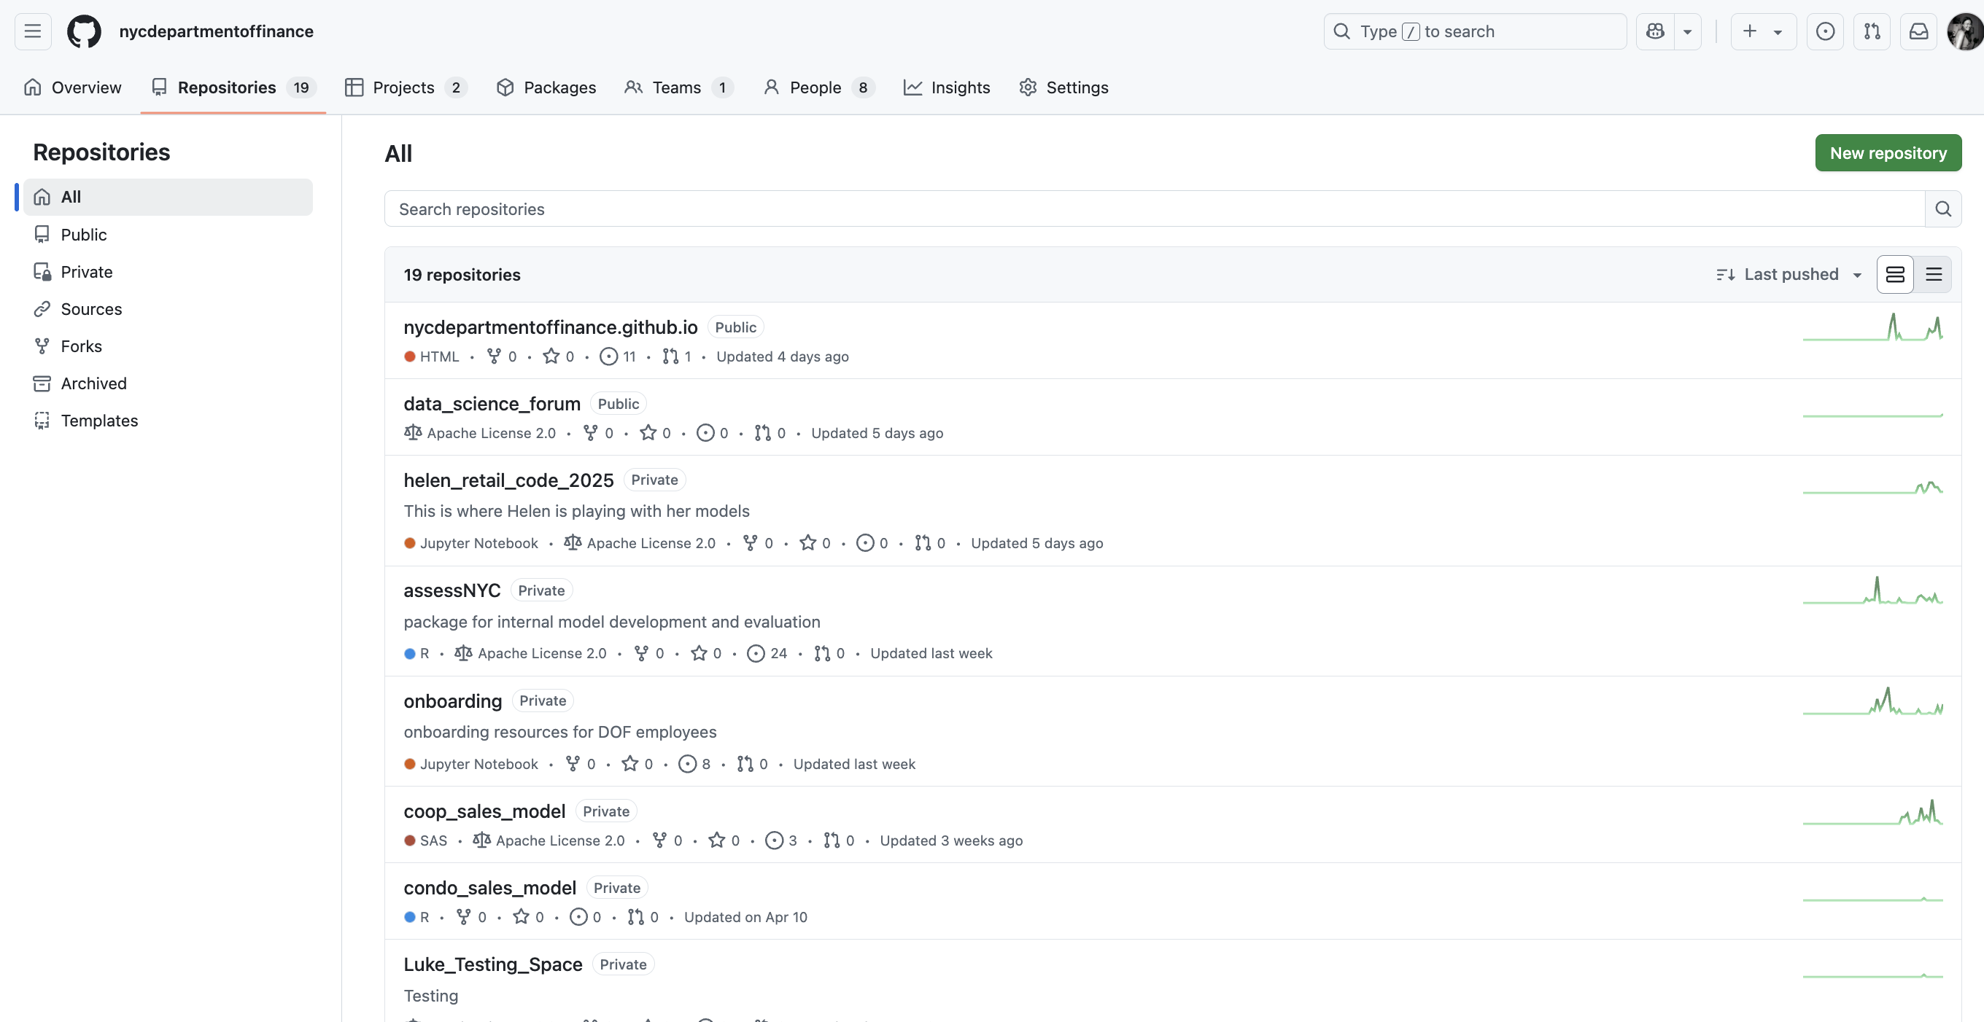
Create homes for all project-related materials, where everyone can access/update them

Slide 42
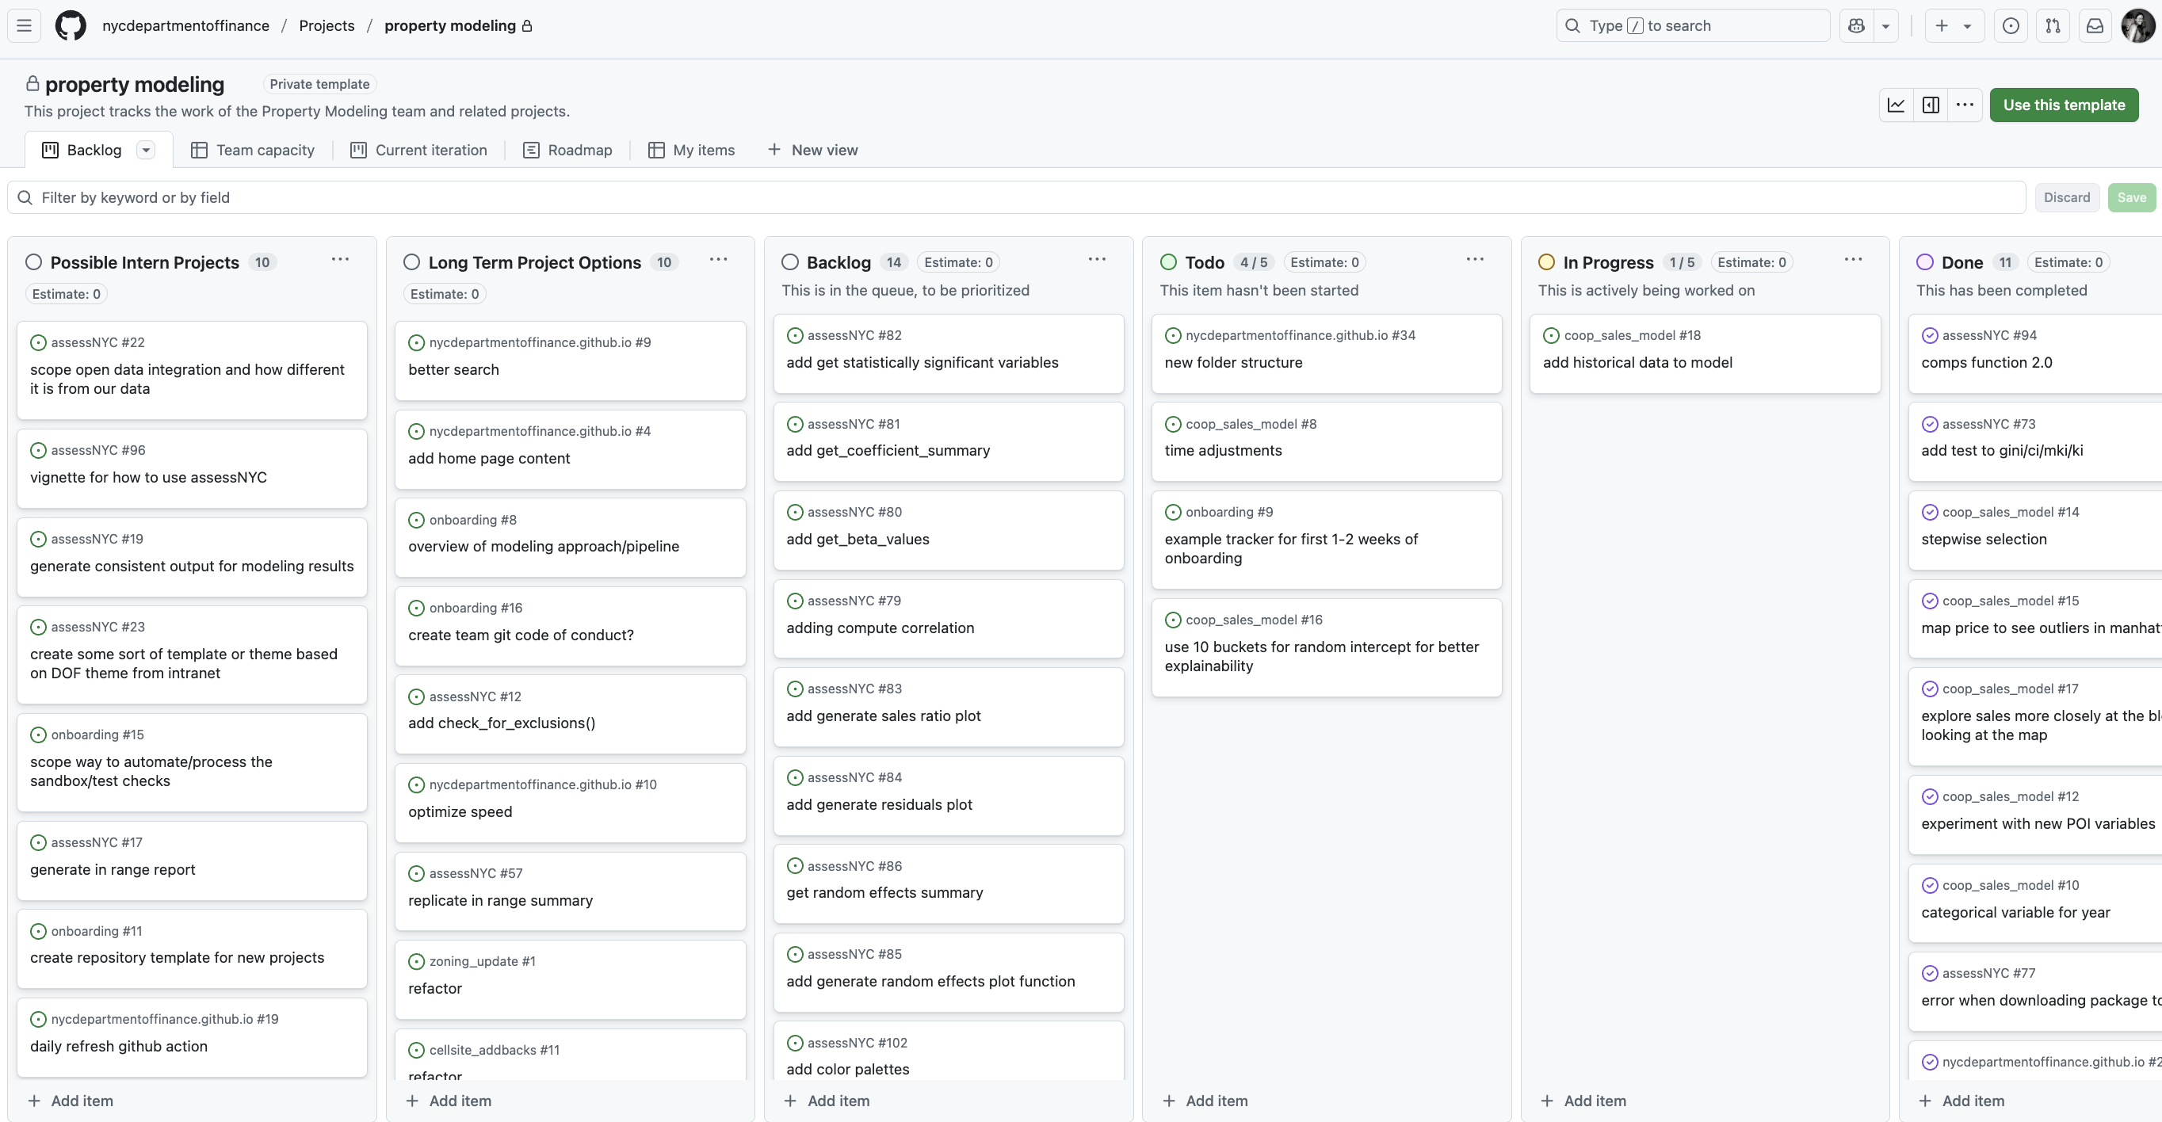
Use it as a project management tool to track progress

Slide 43
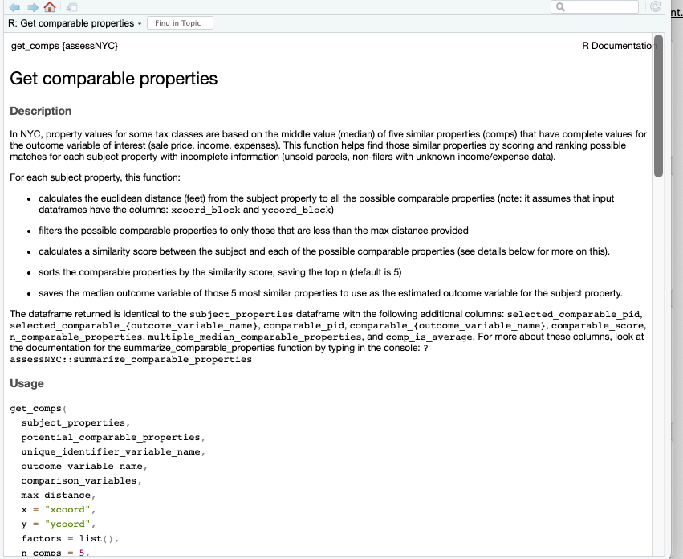
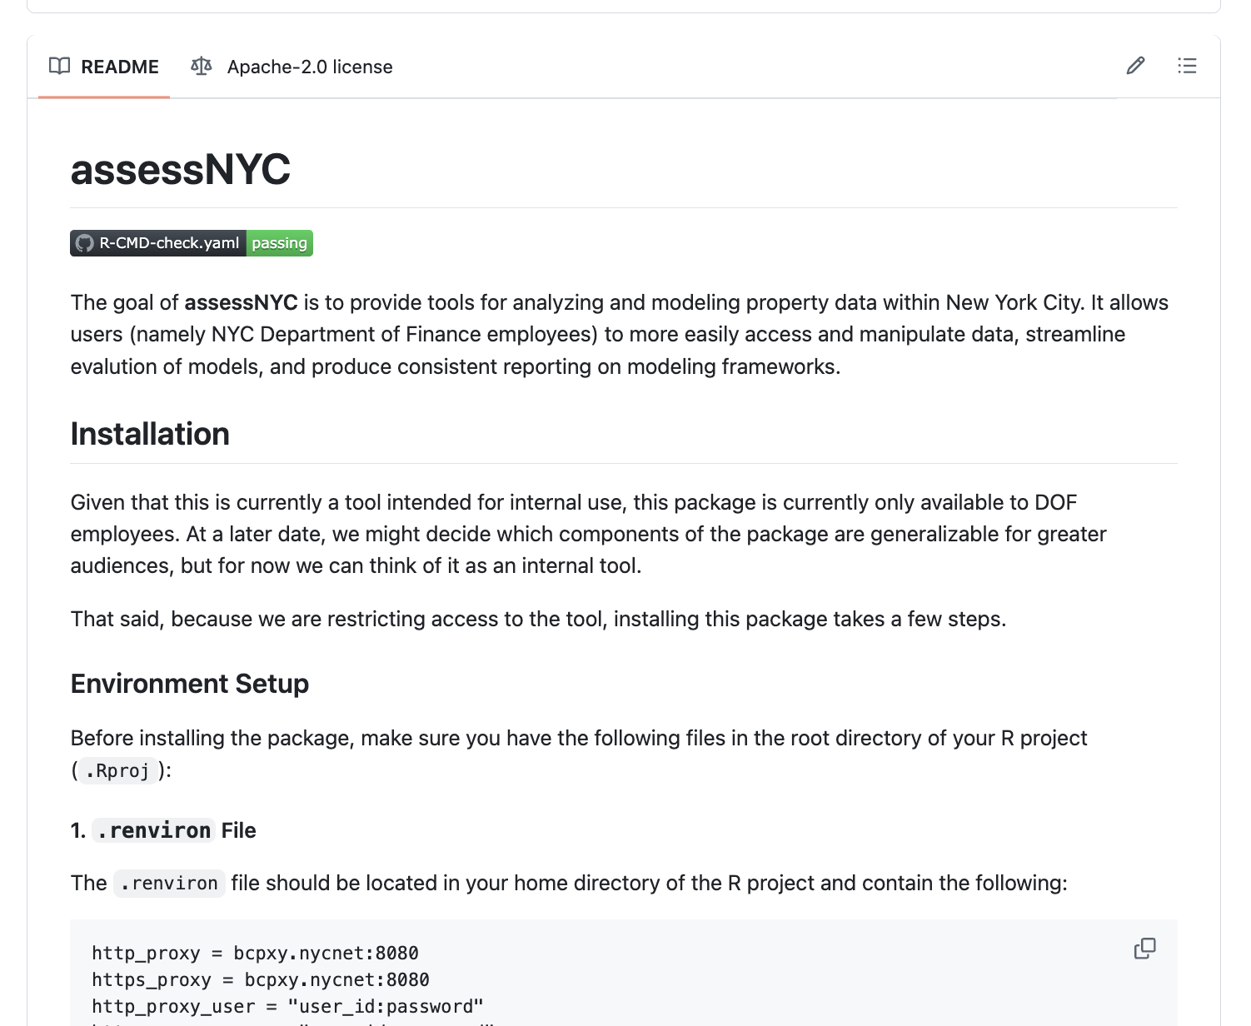
Create packages for internal/external use

Slide 44
Endless other examples!
Git actions to run scripts in virtual machines (not relying on local compute)
Track issues/bugs with code and assign team members to handle next steps
Collaborate with other teams/organizations on projects.
Right now, there are ~85 other GitHub organizations that are being used by NYC city agencies that we can learn alongside!
OTI is preparing a new wave of training around git/GitHub so that there can be more inter-agency collaboration.
Many, many more!

Slide 45
Benefits to DOF for using git/GitHub for building tools
Easily to update/maintain.
Reliant on open-source tools, which often have more documentation and are easier to learn for new users/employees
Flexible across programming languages so that people can code in whatever language is most native to them or depending on what language is best for the tool we are developing
Free and flexible. We don’t need to think about what we want and purchase tons of licenses in order to get access to a tool – we have the flexibility to design and implement the specific types of tools we need (e.g. the comparable property map)

Slide 46
Costs
Right now, everything is free. This means I can add unlimited members to our DOF GitHub Organization and all members
There is no limit for storage or number of private project folders that we can create within our existing free account.
There is currently a file size limit (50 MB) for each individual file that can be uploaded, but that is rarely a limitation for our day to day work.
A new team at OTI has recently claimed access to the GitHub Enterprise (paid) account for the city. In the next few months, they will be giving more guidance on what this means but it could mean the following:
More advanced features on collaboration that would be helpful as more users are added to the GitHub organization
We could use OTI funds to run larger compute jobs if needed

Slide 47
Drawbacks of git/GitHub
It is less secure than just using the G Drive: we have less control over the data security if it is out of our system, but the security protocol for git/GitHub is really sophisticated
Solution: we can keep scripts and non-sensitive data on github, but cannot save any sensitive raw data on github
It is hard to learn and technically difficult: it does take a little while to get the hang of it, but most users will only need to use 5 commands on the command line or can use the GitHub Desktop app that has a point and click interface
Solution: we can offer more training (happy to do this!) on both git on the command line and GitHub Desktop for users interested in different approaches.

Slide 48
Want to try it for yourself?

Slide 49
Opportunities to get started
Install git (https://git-scm.com/) on your local machine or submit a ticket to HelpDesk to ask to have it installed on your behalf
Create a free GitHub account (with your work email): https://github.com/
You need to do this in order to join the DOF GitHub organization
Send me your work email (or drop it in the chat now) and I can add you to our DOF GitHub organization
Explore the resources on our DOF GitHub organization:
Walkthrough some guides I created on how to get set-up: https://github.com/nycdepartmentoffinance/onboarding
Explore existing project code we have already to get a sense of how we use it: https://github.com/orgs/nycdepartmentoffinance/repositories
Create your own repository in our organization to add your own projects

Slide 50
Appendix.

Slide 51
